Slide 1
Title
Yang Xi’s study notes
Feb 2022

Slide 2
What does “Private Equity (PE)” mean to you?
An asset class for investment
Arguably include Venture Capital, Growth Equity, Buyouts, Distressed Debt, etc
Many specialist investment strategies further fragment the asset class.
Transactions, such as Buyout, leveraged buyout (LBO), etc
Venture Capital (VC) investment is usually not considered Private Equity. VC investments are structured very differently, as a unique investment type.
PE firms that organize and invest in buyout transactions
The entire industry of buyout firms

Slide 3
Private Equity Fund
A PE fund generally buys or invests in a company with the intention that it will improve its earnings or value, by providing capital and expertise, and then sell the investment at a profit.
“private” – non-public, unlisted
“equity” – shares, as distinct from property / financial instruments
Investors in a PE fund are mainly institutional investors.
Run by managers, on terms of investment management agreement and trust deed
The PE fund sells its investment in an exit transaction
Sale of company to a 3rd party buyer
Flotation of the company on a stock exchange (IPO)
With a share buy back, to use some or all money raised to buy back the shared held by PE fund
PE funds are usually set up with a lifespan of around 10 years
Initial set of investments ➔ several exits after 3-4 years ➔ another set of investments
Many Secondary Buyouts: one fund buys the shares (equity) from another fund

Slide 4
Private Equity Fund
PE funding is used by companies of all sizes
Start-ups (VC), expansion capital, management buy-outs (MBO), public-to-private deals
In MBO, PE fund teams up with existing senior managers of the target company, to form a new company which acquires the target company.
Leveraging - borrowed funds are used in acquisition
Ranking of funds
Senior Debt, usually provided by a bank
Junior Debt (mezzanine), may be provided by a different financier
Subordinated Debt – another way PE fund to make part of its investment
May be convertible into equity
PE investors

Slide 5
Benefits and Risks of Getting VC and PE Funding
Benefits
Access to capital
Sector expertise and experience
Network and connections
Appetite for risk: a portfolio view, medium-term time horizon
Disadvantages
Loss of control and management autonomy
Lengthy and complex investment process – about 6 months for a series
Uncertainty – there is no guarantee that an investment deal will close
Risk transference to management

Slide 6
Structure of a PE firm
The General Partner (GP) is the PE firm.
GP manages the fund, makes fund investments, aligns interests of the LPs
GP commitment to a fund: the PE firm’s own cash
Typically 1%, but expected to be a meaningful amount of their personal wealth
“skin in the game” - help to align the interests
Cash – cannot be waiver of fees / indirect investment
Fully liable, including negative returns
Limited Partners (LP) – external investors
External investors, including institutional investors and accredited investors.
Passive role – no inputs to the investment decisions
Committed Capital: money raise from LP
Liable for up to the full amount they invest
Operating Partners (OP)
Individuals with operating and industry experience, who help with deal sourcing and portfolio company management

Slide 7
Structure of a PE firm
PE funds typically have a life-cycle of about 10 years
Investment Cycle (5 to 7 years) and Harvest (exit) Cycle (3 to 5 years)
PE funds typically aim to invest around 90% of the fund
Keep ~10% for further investment such as bolt-on acquisitions, further growth capital, etc
A fund will have a specific set of investment criteria
Different funds within a firm may have different goals and objectives
Sector / geography /investment stage / types of deal / investment size …
Firms rarely make cross fund investment
Conflicts of interest from different mix of LPs
Firms grow by raising new funds, as existing funds approach maturity and full investment (closed).
Funds typically charge 2% annual management fee on committed capital.
Usually 20% carried interest, and LPs share 80% of the return
Hurdle rate, usually 7% to 10%, much be achieved on-behalf of the LPs, before the GP can take some or all the performance related carried interest.

Slide 8
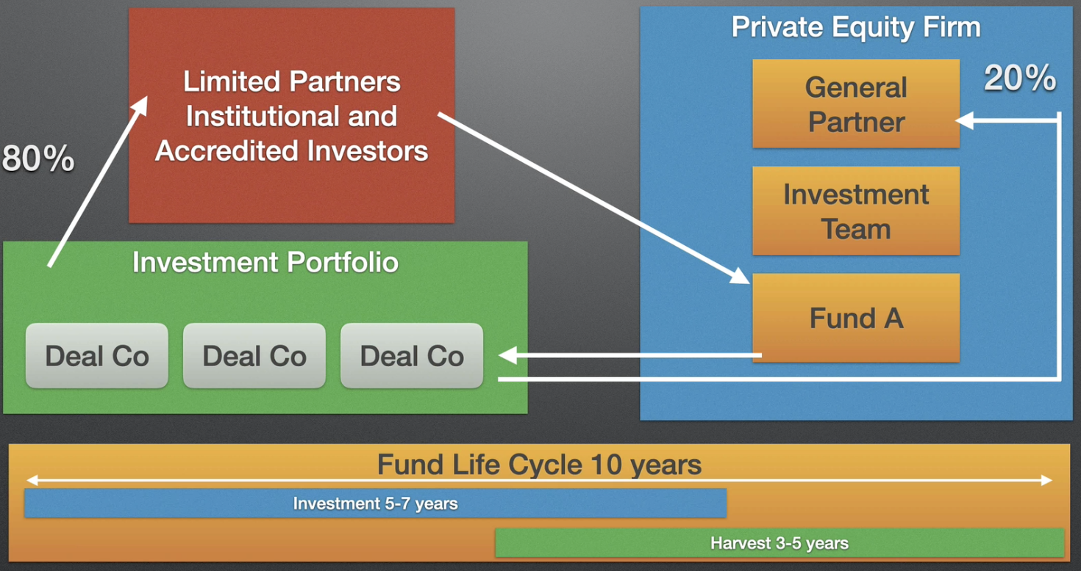
Structure of a PE firm

Slide 9
Limited Partnerships (LP) in PE
When the Fund is raised, GP and LPs sign a Limited Partnership Agreement
LP Clawback Clause: in case that the Fund does not have enough assets to meet liabilities, GP can claw back distributions already paid to the LPs to meet these liabilities
The LPA also outlines the duration of the Fund (~ 10 years). Funds are highly incentivized to exit within this cycle
Organization and Formation
Fund Raising ~ 2 years
Deal Sourcing and Investing ~ 3 years
Portfolio Management
Harvesting (exiting) ~ up to 7 years
Investment criteria: industry, stage, deal type, geography, etc
Limits the maximum investment per company
Key Person Clause: allows the investment to be paused if key person changed
Advisory Board: Consist of LP members, appointed by GP, to give advice, especially
Conflict of interest, Fund term extensions, amendments to the LPA

Slide 10
Executive Roles in a PE Firm
PE firms tend to be much smaller than Investment Banks (IB). The organizational structure is usually flat.
Senior roles
Deal origination, Negotiation & Closing
Portfolio Management, Investment Decision Making
Fundraising
Compliance

Slide 11
Management Buyout (MBO)
A deal in which a business is bough from its owners by its management team, financed by a PE firm.
Common opportunities
Corporate restructuring – to buy the non-core business spun out
Sellout by the controlling shareholders / founders
Sale of the viable part of business, from a collapsed business, by a Receiver / Administrator
Parties in the deal – each has own agenda / priorities / interests / expectations
The seller
The Special Purpose Vehicle (SPV) company formed to make this acquisition
PE and 3rd party funders (usually banks)
Buyout Team – formed by different people within the party
Due Diligence Advisers (lawyers & accountants) – advise the buyers to check the quality and the correctness of the business they are buying
Financial Advisers
Tax Advisers
Legal
…

Slide 12
Management Buyout (MBO)
Funding
Debt / Equity / Working Capital Facilities (loans and overdrafts)
Banks normally provide debt funding
Amount varies from each deal – can be below 10% or above 70%
Banks usually seek to get security over assets – low risk
Earn interest payments and principle repayments
Private Equity (PE)
Maybe 40-50%
Alongside management, control relationship through Shareholder Agreement, which gives them rights and vetos
Management Equity
Usually the smallest amount, like 5-10%, but structured with highest potential capital gain
For the management to have a skin in the game
MBO provides the management with the opportunity to make a substantial capital gain for a relatively modest investment - driven by the management

Slide 13
Leveraged Buyout (LBO)
The core components of LBO are the same as MBO
The core difference:
While an MBO is driven by the management team, An LBO is driven by the PE firms and their financial goals.
The basic idea
Use debt to leverage (multiply) the power of your cash (your own equity)
When you sell, you have used the cash from the business to pay down the debt
This can greatly enhance the value of your original equity investment

Slide 14
More opinions to the MBO myths
The management does not need to contribute millions $ in MBO – the banks and PE firms will provide the bulk of the finance.
This is usually structured and organized by the corporate advisors, normally an IB
MBO can have an advantage over Trade Buyers, especially when the seller is the founder of the business, who trends to prefer the existing management
Investor prefer balanced team – experience, track record, leadership – not necessarily extraordinary
MBOs have been seen succeed in almost all sectors.
Average MBO size in UK is about 25m pounds - medium sized companies, divisions / subsidiaries of large companies
MBOs are not necessarily more risky than other deals.

Slide 15
A
A

Slide 16
A
A

Slide 17
A
A

